Slide 1

Changing the Subject of the Formula
Level 7/8
28/04/15
Learning Objectives:
Able to change the subject of simple linear formulae
Able to change the subject of formulae
involving roots
Able to change the subject of complex
formulae

Slide 2

Changing the Subject of the Formula
Make $x$ the subject of the formula:
$$y = 7x – 2$$
$$y + 2 = 7x$$
$$\frac{y+2}{7}=x$$
(+ 2)
(+ 2)
(÷ 7)
(÷ 7)

Slide 3

Changing the Subject of the Formula
Make $m$ the subject of the formula:
$$y =3mn −n$$
$$y +n =3mn$$
$$\frac{y+n}{3n}=m$$
(+ n)
(+ n)
(÷ 3n)
(÷ 3n)

Slide 4

Changing the Subject of the Formula
Make $p$ the subject of the formula:
$$R =\frac{4−5p}{6} + 2$$
$$R − 2 = \frac{4−5p}{6}$$
$$6\left(R−2\right)=4−5p$$
$$6R – 12 = 4 – 5p$$
$$6R – 16 = −5p$$
$$\frac{6R−16}{−5}=p$$
(- 2)
(- 2)
(x 6)
(x 6)
(- 4)
(- 4)
(÷ -5)
(÷ - 5)

Slide 5

Changing the Subject of the Formula
Make $d$ the subject of the formula:
$$e = cd2 – c$$
$$e + c = cd2$$
$$\frac{e+c}{c}=d^{2}$$
$$\sqrt{\frac{e+c}{c}}=d$$
(+ c)
(+ c)
(÷ c)
(÷ c)
(√)
(√)

Slide 6

Changing the Subject of the Formula
Make $f$ the subject of the formula:
$$e =\sqrt{\frac{4f^{2}}{5}}$$
$$e^{2} = \frac{4f^{2}}{5}$$
$${5e}^{2}={4f}^{2}$$
$$\frac{5e^{2}}{4}=f^{2}$$
$$\sqrt{\frac{5e^{2}}{4}}=f$$
(square)
(square)
(x 5)
(x 5)
(÷ 4)
(÷ 4)
(√)
(√)

Slide 7
Changing the Subject of the Formula
Page 105
Exercise 5N
Q1 to 7
Q8 to 12
Q13 to 21

Slide 8
Changing the Subject of the Formula
If the term you are making the subject appears more than once, you will need to factorise at some point

Slide 9
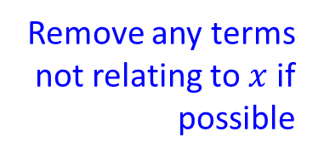
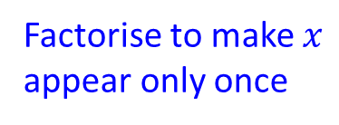

Changing the Subject of the Formula
Make $x$ the subject of the formula:
$$y = wx + w – 5x$$
$$y – w = wx – 5x$$
$$y – w = x(w – 5)$$
$$\frac{y−w}{w−5}=x$$
Remove any terms not relating to $x$ if possible
(- w)
(- w)
Factorise to make $x$ appear only once
(÷ (w – 5))
(÷ (w – 5))

Slide 10
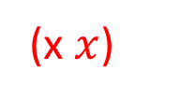
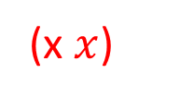
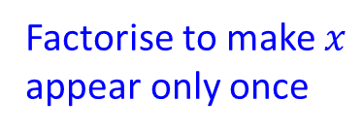
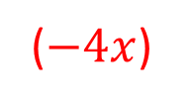
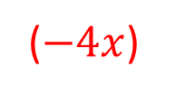

Changing the Subject of the Formula
Make $x$ the subject of the formula:
$$y =\frac{4x−5}{x}$$
$$xy =4x – 5$$
$$xy –4x = – 5$$
$$x(y – 4) = −5$$
$$x=\frac{−5}{y−4}$$
(x $x$)
(x $x$)
($−4x$)
($−4x$)
Factorise to make $x$ appear only once
(÷ (y – 4))
(÷ (y – 4))

Slide 11
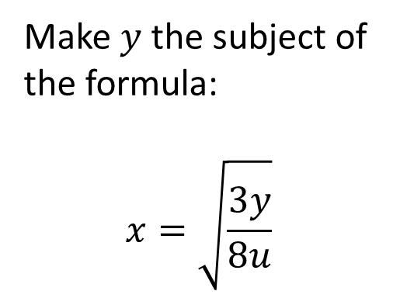
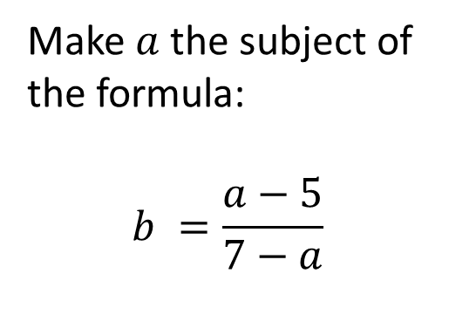
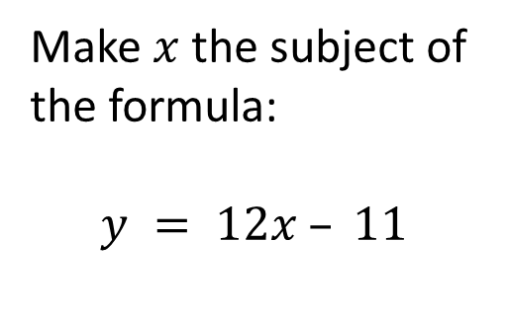
Starter
C
B
A
Make $x$ the subject of the formula:
$$y = 12x – 11$$
Make $y$ the subject of the formula:
$$x=\sqrt{\frac{3y}{8u}}$$
Make $a$ the subject of the formula:
$$b =\frac{a−5}{7−a}$$

Slide 12
Changing the Subject of the Formula
Page 370
Exercise 19H
Q1 to 10

